Slide 1
PORTFOLIO SUBMISSION Applied Data Sciences
Joyce Woznica SID: 37463397
Notes:
Welcome to my portfolio review for my graduation from Syracuse University Applied Data Sciences Masters program.

Slide 2
AGENDA
01 Why we are here
02 The Syracuse ADS Program
03 Key Projects
04 Summary
05 Reflection
Notes:
So quickly – let’s review the agenda for this presentation.
First, I’ll introduce you to why you are listening to this (and yes, why my slides have horses on them).
Next, I’ll explain the learning objectives for the Applied Data Science Program at Syracuse University.
Then I’ll talk about how I satisfied these learning objectives with some key projects in my course work.
Then I will do a brief summary of these projects and objectives and then finish up with some reflection.

Slide 3
01
Why we are here
Understanding what got me to the program
Notes:
Let’s start with what got me in this position

Slide 4
01
Why we are here
Understanding what got me to the program
My daughters are competitive equestrians.
Riding is something that they love and I love doing with them.
I have always been interested in numbers and patterns.
I was facing the empty nest.
Seemed like a great way to combine passions.
Notes:
There are six short weeks remaining in the horse show season in 2006 — my daughters and their horses are trying to hang on to their ranking so that they will qualify for state finals and year-end awards for their efforts throughout the season.
I have gathered data over the season for each show that they have attended which includes:
the judge
the classes entered by each daughter
which horse was ridden in each class
their placing in each class
personal comments about the judge and what he/she was looking for in each class
Using this information, my daughters and I plan the remaining six weeks to maximize their potential to score additional points (each placing has an associated point
value).
The outcome: they made it to state finals and placed in the top two for their year-end awards in their respective divisions. Little did I know, I was doing rudimentary data analytics (without the assistance of programming and machine learning) to predict the outcome of the future shows. This “manual” method remained a mainstay
throughout my daughters’ amateur junior career in the saddle.
Fast forward a decade and both girls (and their horses) are in college, and I am looking at an empty nest as a single parent. I know that work and riding my own horse will not fill the gap of dealing with teenage girls over the past several years, so I had to come up with a plan for filling my days while they were gone — enter graduate school at the age fifty-seven. I selected the Syracuse Applied Data Analytics program because it addressed applying data analytics to specific business problems to
achieve an outcome.
This portfolio combines my obsession with numbers and data with my passion for horses and clearly represents my progression and acquired skills throughout
the program.

Slide 5
02
The Syracuse Applied Data Science Program
Notes:
I want to take a moment to summarize the Applied Data Science program and learning objectives.

Slide 6
Program Focus Areas
Describing a broad overview of the major practice areas of data science.
Collecting and organizing data.
Identifying patterns in data via visualization, statistical analysis, and data mining.
Developing alternative strategies based on the data.
Developing a plan of action to implement the business decisions derived from the analyses.
Demonstrating communication skills regarding data and its analysis for managers, IT professionals, programmers, statisticians, and other relevant professionals in their organization.
Synthesizing the ethical dimensions of data science practice (e.g., privacy).
Notes:
Syracuse Applied Data Science Program
The Syracuse Applied Data Science program is interdisciplinary providing students with a diverse program in a board range of areas. This program focuses on seven main areas:
Describing a broad overview of the major practice areas of data science.
Collecting and organizing data.
Identifying patterns in data via visualization, statistical analysis, and data mining.
Developing alternative strategies based on the data.
Developing a plan of action to implement the business decisions derived from the analyses.
Demonstrating communication skills regarding data and its analysis for managers, IT professionals, programmers, statisticians, and other relevant professionals in their organization.
Synthesizing the ethical dimensions of data science practice (e.g., privacy).

Slide 7
03
Key Projects
Notes:
So – faced with all these objectives, what projects helped me achieve them?

Slide 8
Key Projects Noted
The following projects were noted to show how these seven learning objectives were satisfied:
IST 659 - Data Administration Concepts and Database Management
MBC 638 - Data Analysis and Decision Making
IST 707 - Data Analytics
IST 719 - Information Visualization
IST 652 - Scripting for Data Analytics
IST 664 - Natural Language Processing
Notes:
Ok, a little reality check – I am a more is more person and I had a very difficult time narrowing down which projects to talk about.
So, here’s my list. Trust me – it was a very difficult decision for me!
IST 659 - Data Administration Concepts and Database Management
MBC 638 - Data Analysis and Decision Making
IST 707 - Data Analytics
IST 719 - Information Visualization
IST 652 - Scripting for Data Analytics
IST 664 - Natural Language Processing

Slide 9
IST 659
Data Administration Concepts and Database Management
Professor Chad Harper
Notes:
Let’s start with Data Administration Concepts and Database Management which I took under the guidance of Chad Harper.

Slide 10
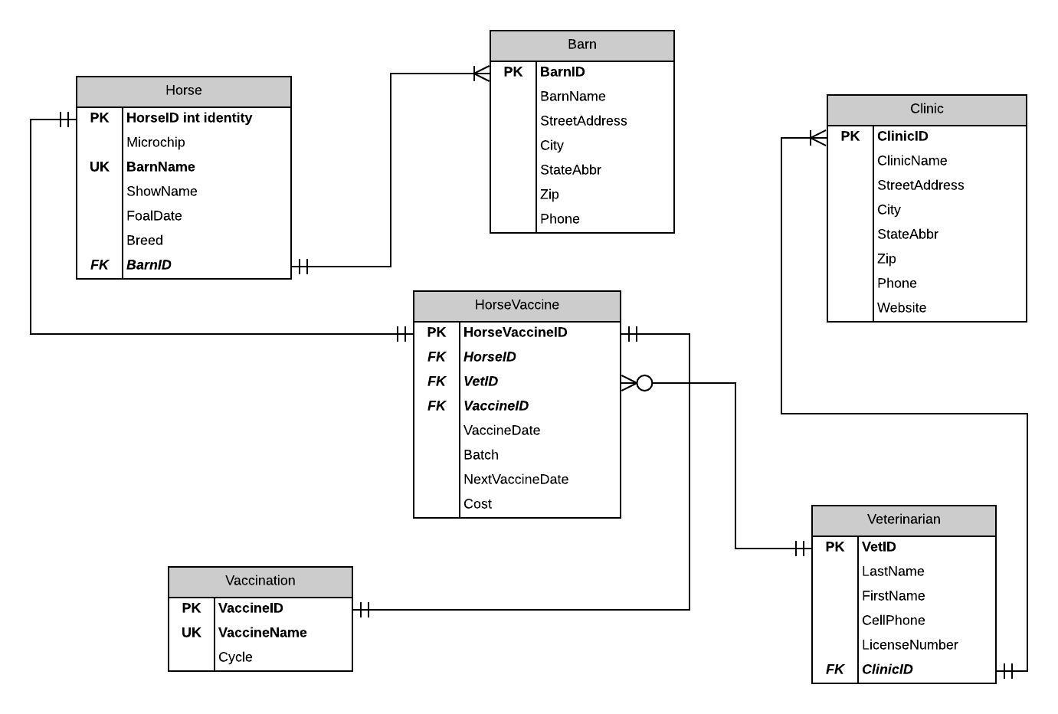
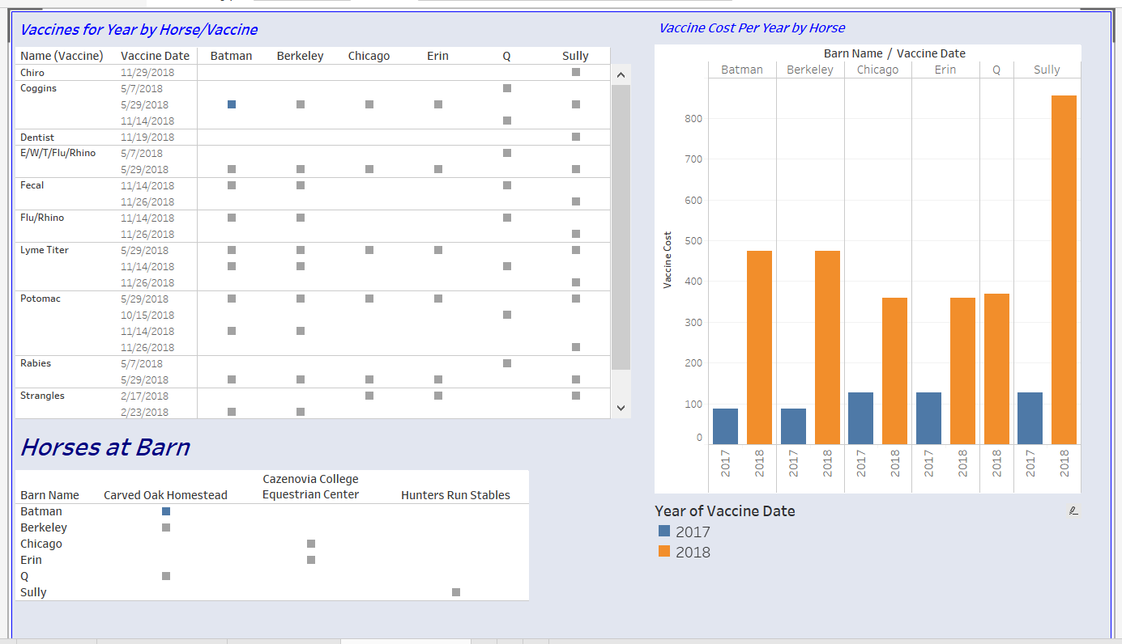
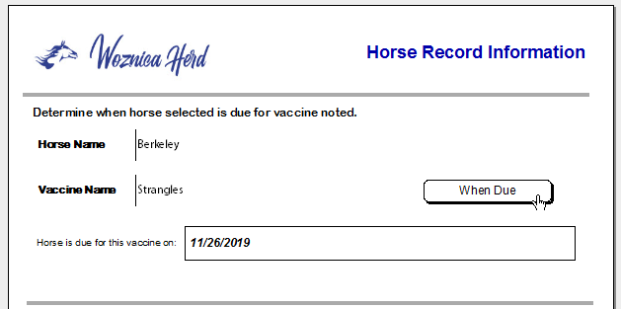
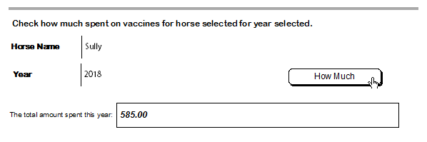
Horse Records
Replace with your own text
Notes:
A key goal of this course was building a normalized database, understanding the relationship between database tables and then adding and extracting information from the database to answer questions.
As an owner of multiple horses that have been in different states with different veterinary options for vaccines and other routine medical work, it is very difficult to keep track of each horse’s vaccine schedule and other pertinent information. By providing a single database of all my horses and their vaccine history, a solution was developed to maintain this information and provide reminders as well as recommendations for future routine work. For this project, I created a database that tracked of my
horses’ vaccines as well as all their dentist, chiropractor and other routine medical visits.
This course taught me the importance of data collection and organization. This project consisted of the merging of data from multiple sources and organizing the data into a normalized database that you can see in the figure on the left.
We also worked on writing procedures to answer real-life questions like “when is my horse due for a specific vaccination?” or “how much did I spend on vaccinations in 2018?” we built some User interfaces to allow querying the database for this type of information and then to also display information in dashboard format. Using
visualizations proved very insightful and a great way to refine the information.
Although the plan of action for this project was limited to my plan for this course, it did position me to implement that plan of revising and fine tuning so that the end state of being able to gain insight into my horses and their costs as well as have a place to store this important data.
Finally, learning to communicate to different audiences and levels was a key objective and one that will likely be the most utilized in the future. Talking at the right level and delivering the right information is key to any project.

Slide 11
Learning Objectives Satisfied
Collecting and organization data
Identifying patterns in data via visualization, statistical analysis, and data mining
Developing a plan of action to implement the business decisions derived from analysis
Demonstrating communication skills regarding data and its analysis for managers, IT professionals, programmers, statisticians, and other relevant professionals in their organization
Notes:
Collecting and organization data
Identifying patterns in data via visualization, statistical analysis, and data mining
Developing a plan of action to implement the business decisions derived from analysis
Demonstrating communication skills regarding data and its analysis for managers, IT professionals, programmers, statisticians, and other relevant professionals in their organization

Slide 12
MBC 638
Data Analysis and Decision Making
Professor Lynn Gill
Notes:
Next class that found to be very instrumental in satisfying various learning objectives in the Syracuse program was Data Analysis and Decision Making with Lynn Gill.

Slide 13
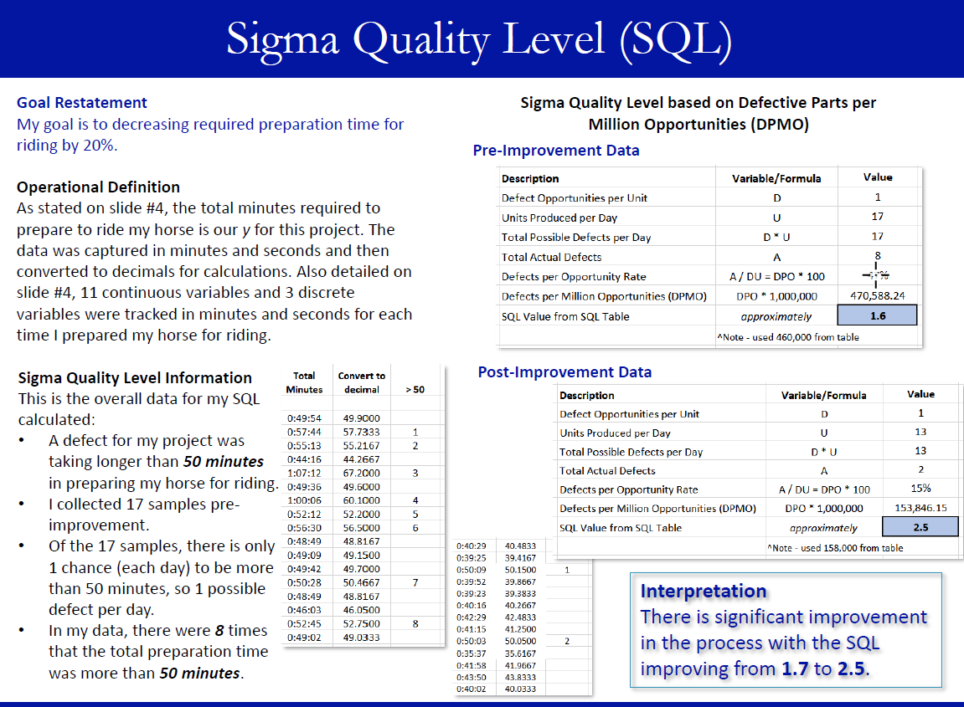
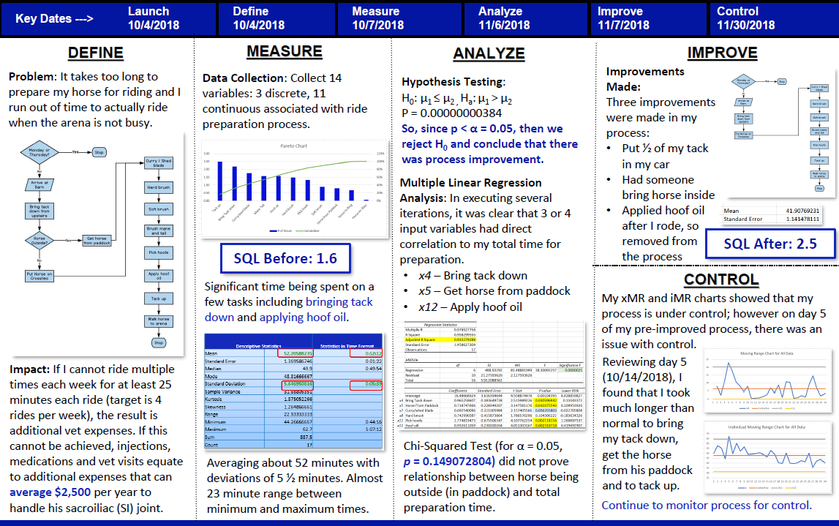
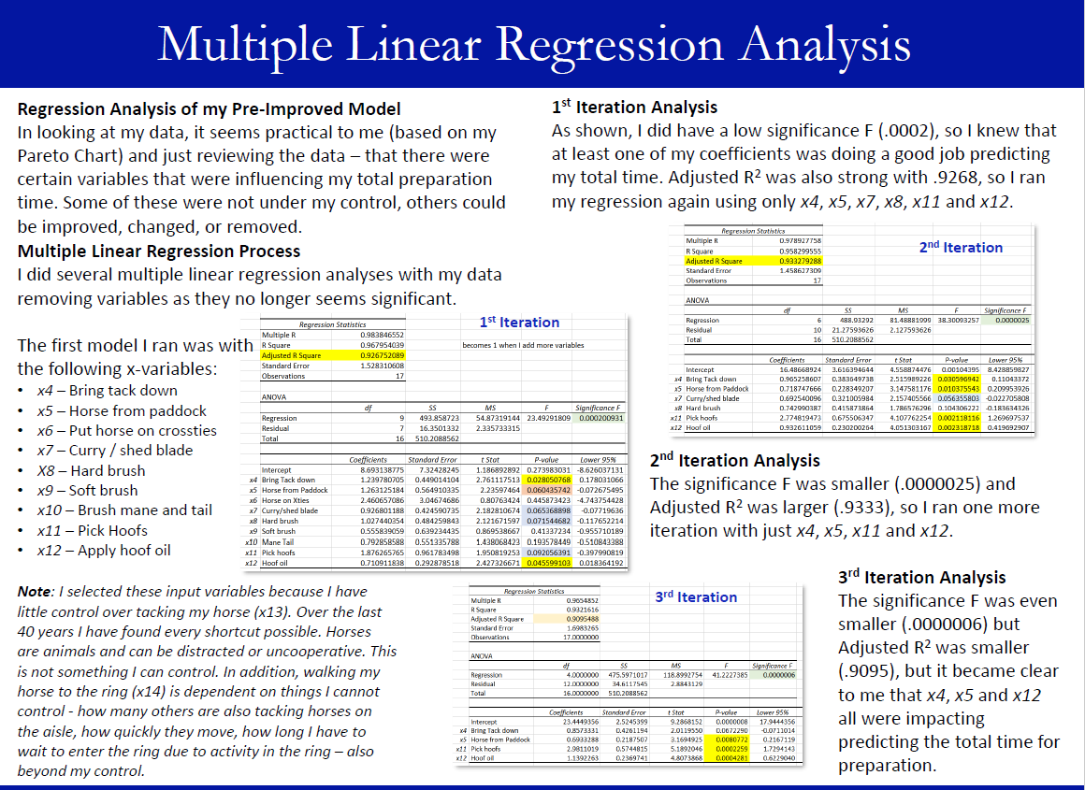
Horse Ride Preparation Process Improvement
Replace with your own text

Slide 14
Learning Objectives Satisfied
Describing a broad overview of the major practice areas of data science
Collecting and organization data
Developing a plan of action to implement the business decisions derived from analysis
Developing alternative strategies based on data
Demonstrating communication skills regarding data and its analysis for managers, IT professionals, programmers, statisticians, and other relevant professionals in their organization

Slide 15
IST 707
Data Analytics
Professor Jeremy Bolton

Slide 16
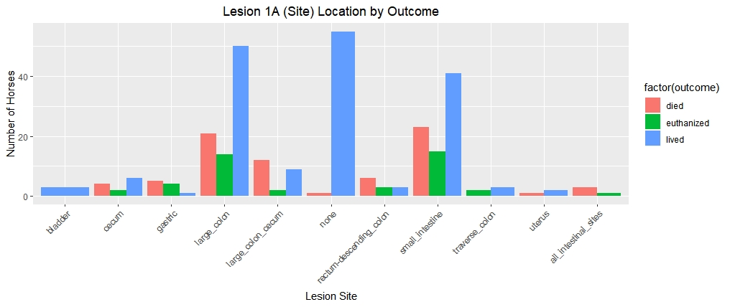
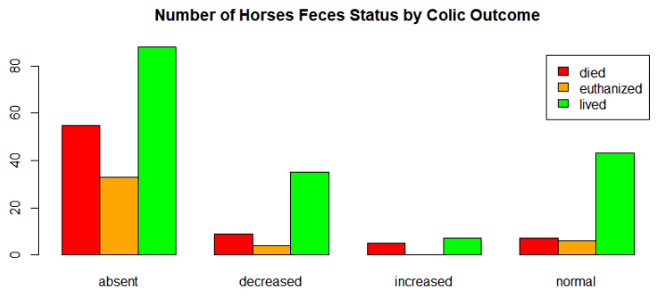
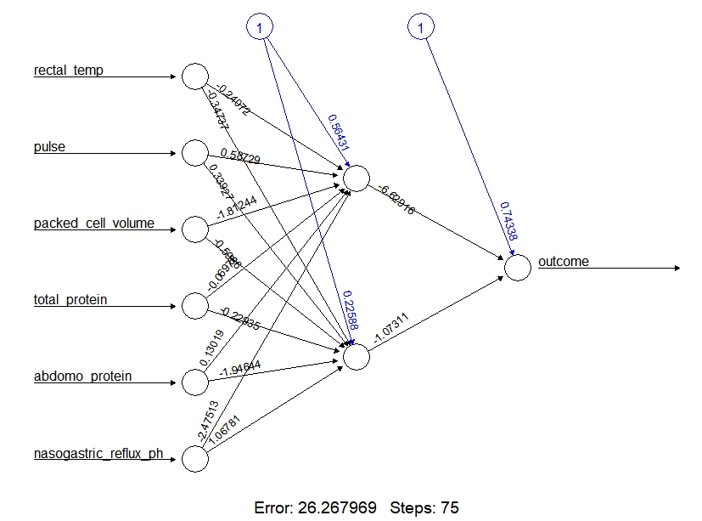
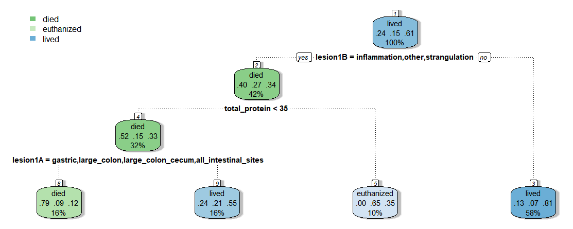
Predicting Horse Colic
Replace with your own text

Slide 17
Learning Objectives Satisfied
Identifying patterns in data via visualization, statistical analysis, and data mining
Developing alternative strategies based on data
Developing a plan of action to implement the business decisions derived from the analyses

Slide 18
IST 719
Information Visualization
Professor Gary Krudys

Slide 19
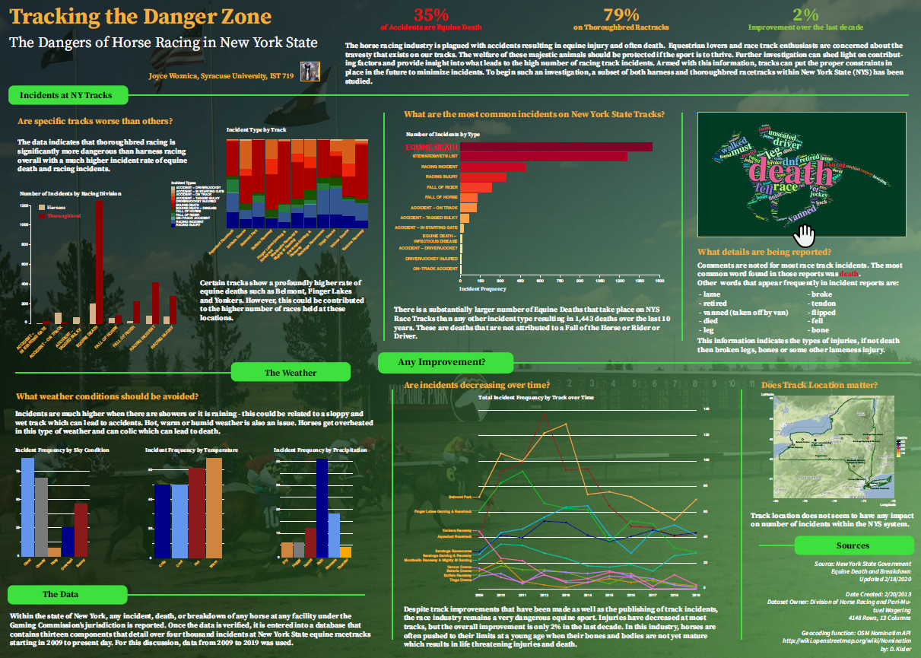
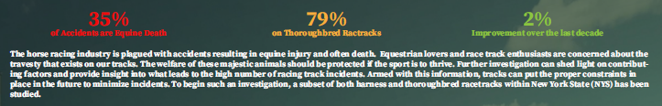
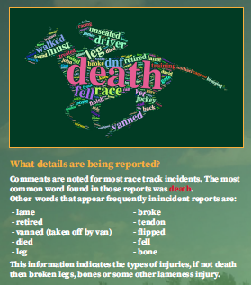
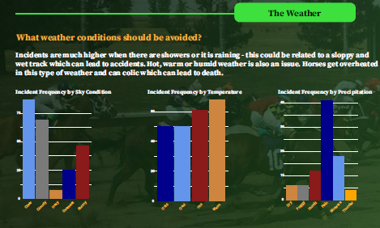
Tracking the Danger Zone: Horse Track Incidents
Replace with your own text

Slide 20
Learning Objectives Satisfied
Identifying patterns in data via visualization, statistical analysis, and data mining
Demonstrating communication skills regarding data and its analysis for managers, IT professionals, programmers, statisticians, and other relevant professionals in their organization
Synthesizing the ethical dimensions of data science practice (e.g. privacy)

Slide 21
IST 652
Scripting for Data Analytics
Professor Deborah Landowski

Slide 22
Racetrack Infractions and Incidents
Replace with your own text

Slide 23
Learning Objectives Satisfied
Collecting and organization data
Identifying patterns in data via visualization, statistical analysis, and data mining
Developing alternative strategies based on data
Developing a plan of action to implement the business decisions derived from the analysis
Demonstrating communication skills regarding data and its analysis for managers, IT professionals, programmers, statisticians, and other relevant professionals in their organization
Synthesizing the ethical dimensions of data science practice (e.g. privacy)

Slide 24
IST 664
Natural Language Processing
Professor Norma Palomino

Slide 25
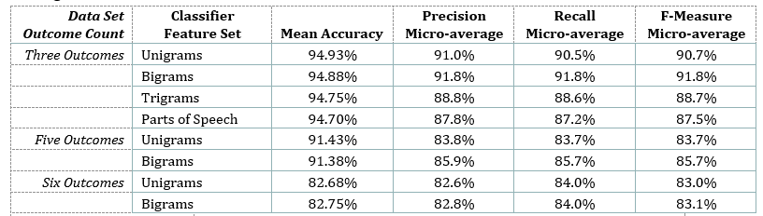
Classification of Racetrack Incidents
Replace with your own text

Slide 26
Learning Objectives Statisfied
Identifying patterns in data via visualization, statistical analysis, and data mining
Developing alternative strategies based on data
Demonstrating communication skills regarding data and its analysis for managers, IT professionals, programmers, statisticians, and other relevant professionals in their organization

Slide 27
04
Summary

Slide 28
Summary of Projects and Objectives
Course | Objectives Satisfied
IST 659 – Data Administration and Database Management | Collecting and organization data Identifying patterns in data via visualization, statistical analysis, and data mining Developing a plan of action to implement the business decisions derived from analysis Demonstrating communication skills regarding data and its analysis for managers, IT professionals, programmers, statisticians, and other relevant professionals in their organization
MBC 638 – Data Analysis and Decision Making | Describing a broad overview of the major practice areas of data science Collecting and organization data Developing a plan of action to implement the business decisions derived from analysis Developing alternative strategies based on data Demonstrating communication skills regarding data and its analysis for managers, IT professionals, programmers, statisticians, and other relevant professionals in their organization
IST 707 – Data Analytics | Identifying patterns in data via visualization, statistical analysis, and data mining Developing alternative strategies based on data Developing a plan of action to implement the business decisions derived from the analyses
Notes:
IST 659 - Data Administration Concepts and Database Management
MBC 638 - Data Analysis and Decision Making
IST 707 - Data Analytics
IST 719 - Information Visualization
IST 652 - Scripting for Data Analytics
IST 664 - Natural Language Processing

Slide 29
Summary of Projects and Objectives
Course | Objectives Satisfied
IST 719 – Information Visualization | Identifying patterns in data via visualization, statistical analysis, and data mining Demonstrating communication skills regarding data and its analysis for managers, IT professionals, programmers, statisticians, and other relevant professionals in their organization Synthesizing the ethical dimensions of data science practice (e.g. privacy)
IST 652 – Scripting for Data Analytics | Collecting and organization data Identifying patterns in data via visualization, statistical analysis, and data mining Developing alternative strategies based on data Developing a plan of action to implement the business decisions derived from the analysis Demonstrating communication skills regarding data and its analysis for managers, IT professionals, programmers, statisticians, and other relevant professionals in their organization Synthesizing the ethical dimensions of data science practice (e.g. privacy)
IST 664 – Natural Language Processing | Identifying patterns in data via visualization, statistical analysis, and data mining Developing alternative strategies based on data Demonstrating communication skills regarding data and its analysis for managers, IT professionals, programmers, statisticians, and other relevant professionals in their organization
Notes:
IST 659 - Data Administration Concepts and Database Management
MBC 638 - Data Analysis and Decision Making
IST 707 - Data Analytics
IST 719 - Information Visualization
IST 652 - Scripting for Data Analytics
IST 664 - Natural Language Processing

Slide 30
05
Reflection
Notes:
Ok – let’s wrap this up with some reflection on the subject

Slide 31
Your great subtitle in this line
Replace with your own text

Slide 32
THANK YOU

